Slide 1

Opening a Gym in London 2021
Carter C

Slide 2
London’s Health 2021
London is a sprawling city with a population of roughly 8.6 million people. It is by far the largest city in the United Kingdom.
Over the past several years obesity has been on the rise within the UK. Organisations, such as, Cancer Research UK declared obesity to be the second biggest cause of preventable cancer in the UK in early 2021.
Obesity related fatalities has further been exacerbated by the appearance of the Covid-19 pandemic.
The Royal Society of Public Health estimated that for the severely obese, at a population infection rate of 10%, there is a direct impact of 240 and 479 excessive deaths in England and an indirect effect of 383 -767 deaths.
The prevention of obesity and promotion of physical activity are as important as physical isolation during the pandemic
Therefore, it is advantageous for individuals to consider increasing their physical activity levels.

Slide 3
The problem
What is the ideal way to become more physical active, or how can one stay in shape as lockdown restrictions are lifted.
There is a potential of contracting Covid and the potential of future lockdown restrictions
Data, however, might prove effective in alleviating some of these worries.
We can aim to predict which areas are likely to improve on over health of their borough and which borough may be more resistant to a high reproduction rate of covid in the future

Slide 4
Target Audience
those who are looking to move to a specific London borough
those who are looking to increase their physical activity or maintain their current physical activities
those who are looking to switch or go to a gym
And those who are looking to obtain property or land with the intent of opening a gym or physical activity business

Slide 5
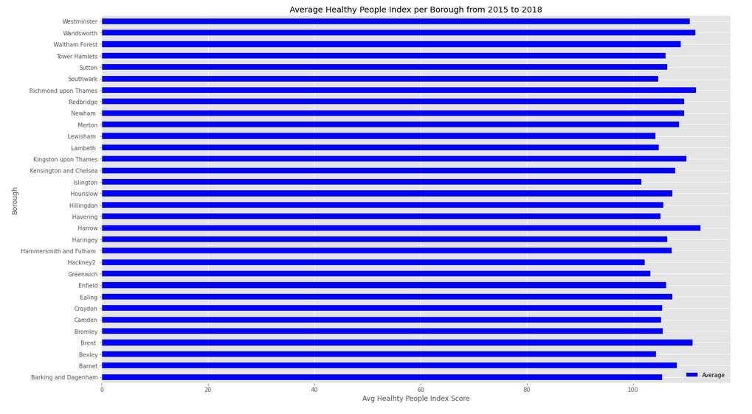
Health Trends

Slide 6
Health Trends
This bar graph although a little cluttered, visualises the average improvements that each borough has seen over between 2015 – 2018 for the Healthy People Index.
it doesn't necessarily reflect whether these boroughs are improving or deteriorating. It just tells the average state over the years.
So, to better visualise the changes the borough has been through over the years would be to taking the average of the changes between each year, rather than just the average of the scores.

Slide 7
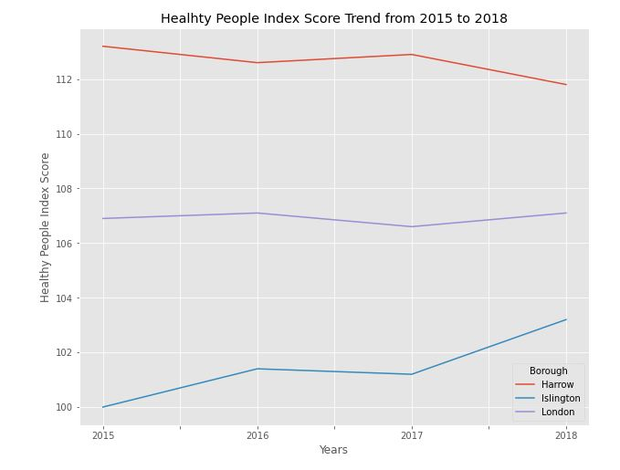

Slide 8
Here we can see that despite, the fact that Harrow had a much higher average score than Islington in the HP index
Whereas, Islington, on the other hand, have seen incredible improvement from 2015 to 2018.
By examining the trend of these two boroughs against the trend for the whole of London over the same period. We are able to see that Islington, like that of London, is on an upwards trend, albeit that London’s overall increase is marginal in comparison to Islington.
It seems then, to have a better picture of whether or not a borough is improving. We should take the average of the changes between each year rather than just the average scores.

Slide 9
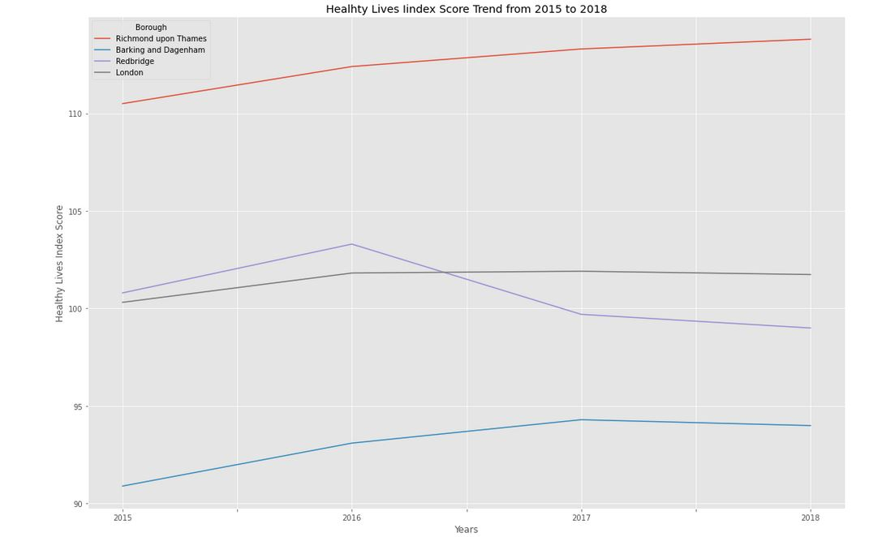

Slide 10
Barking has experienced some stagnation and a slight decline in improvement from 2017 to 2018. Whereas, Richmond Upon Thames has simply continued to improve in this aspect.
This is become increasingly peculiar when we look at the third borough: Redbridge.
Although, its score throughout the years is much closer to that of London's overall trend. There are much steeper kinks in its trend line
It does imply that despite all being a part of London, each borough experiences completely different economic and social changes.

Slide 11
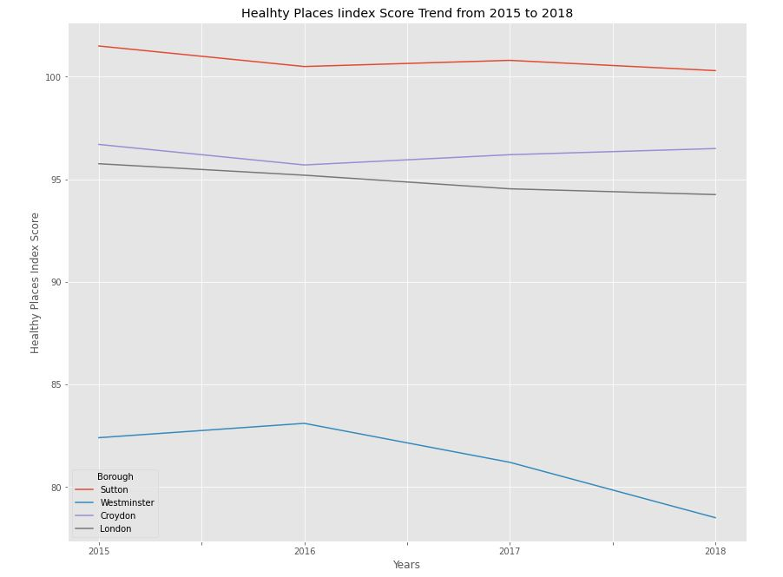

Slide 12
The lowest ranked boroughs are Westminster, Camden, and Kensington and Chelsea respectively. Whereas the top scorers are Havering, Bexley, and Sutton respectively
The boroughs ranked at the lower end are all situated deep within the centre of the city, where there is less likely to be lots of greener spaces.
What's more is that both of these boroughs are in line with the overall trend of London, which has also declined over the years
One explanation or presumption is that this score will always trend downhill as population increase.

Slide 13
London’s Healthiest Boroughs
The overall score of each borough is the average of all of its subdomains each year.
Crucially, though, the following analysis will go a step further and look at the average change that each borough has seen over the years
This is important to members in the target audience that are looking at capitalising on boroughs that are developing and will have better scores in the future.

Slide 14
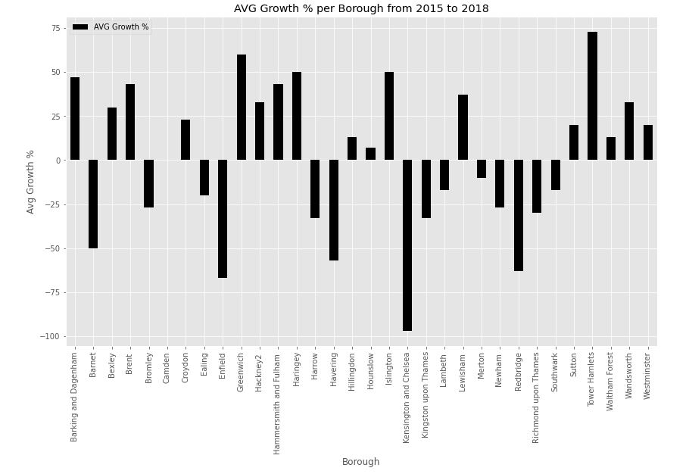

Slide 15
London’s Healthiest Boroughs
it can be used to assess whether there is a borough that is improving and could be potential areas to open a gym.
This is particularly the case with Tower Hamlets
Tower Hamlets has seen a very drastic improvement in its Health Index from 2015 to 2018.
This could potentially mean that the borough is seeing a lot of development and could continue to improve further down the line.
As a business owner or potential business owner this is can be incredibly attractive

Slide 16
Vaccine Data
Enfield, at the time of this data set was produced has the highest number of fully vaccinated residents.
Enfield could potentially be one of the more robust boroughs in London to future lockdowns and covid case
Tower Hamlets current has the highest number of residences who have received one does of the vaccine.
Tower Hamlets will have the highest rate of vaccinated residence, provided they maintain an efficient vaccination rate
Tower Hamlets are a borough that it on the rise and for prospective gym owners or business owners Tower Hamlets tend could be very enticing.

Slide 17
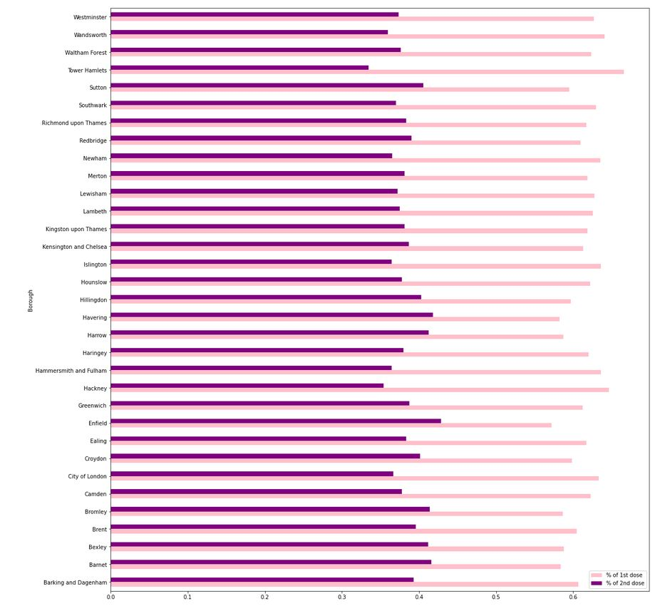

Slide 18
Joining a gym
With the top % most common venues of we can see that there are two boroughs that have Gyms as there 4th most common type of venue
These two being Southwark and Bromley
High chance that there is an increased amount of price competition between gyms. They will have more competitive price ranges.
Bromley ranks as one of the higher boroughs on the health index
Southwalk has a lower ranking on the health index it as well as % of fully vaccinated residents
It does have one of the higher number of residents who have has at least one vaccination
There is a high probability that Southwalk has a high number of fully vaccinated residents and is hopefully more robust to the spread of covid19

Slide 19
Opening a Gym
Those interested in a longer-term return then areas such as Tower Hamlets might be a good investment now
However, a shorter-term solution may be Havering.
It ranks rather high on both the health index
Havering, is also one of the boroughs with a higher number of fully vaccinated residents so it too may be more resistant to the spread of covid
Unfortunately, by looking at Havering's top 5 venues there are none that indicate that health nor fitness is a high priority in Havering.

